Slide 1
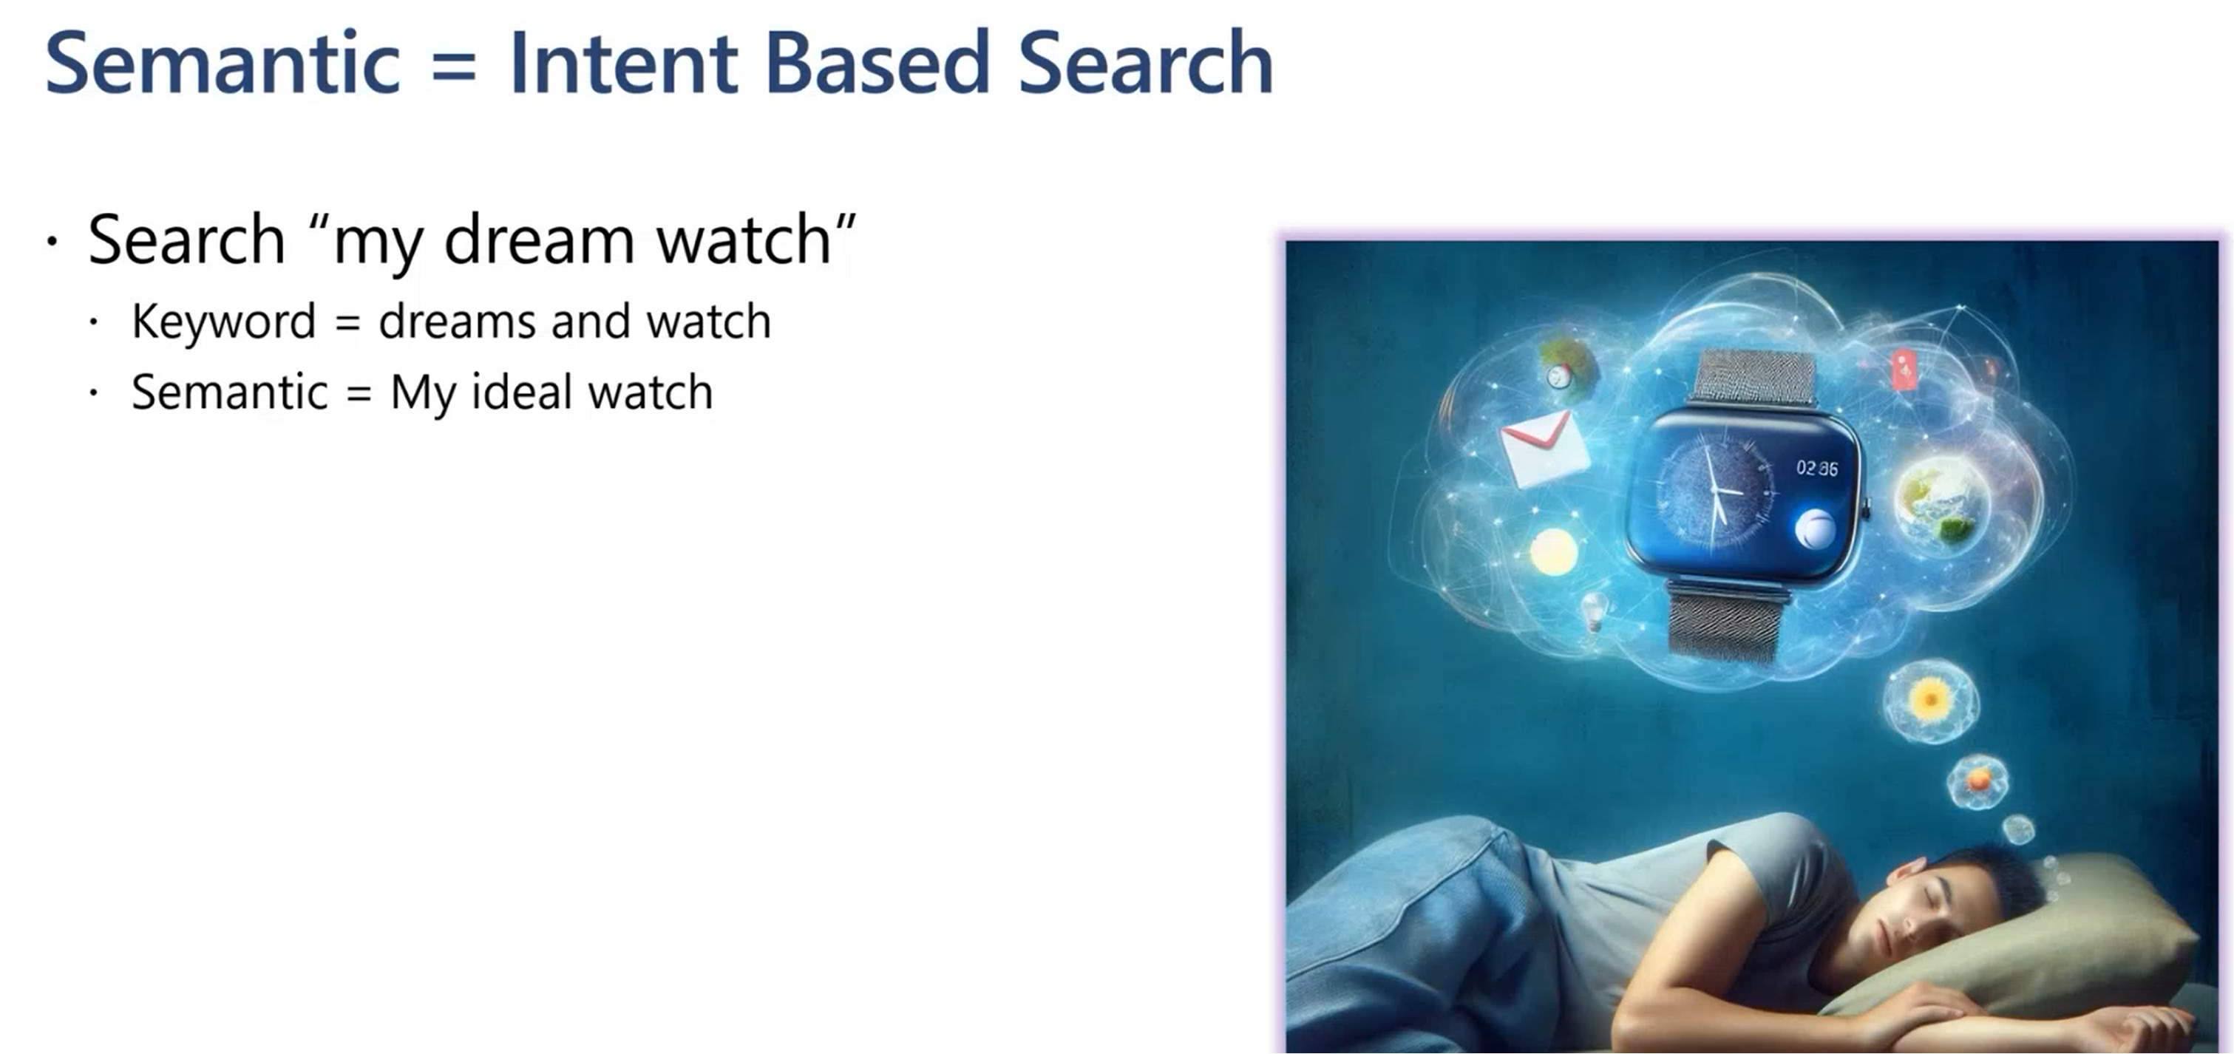

Slide 2
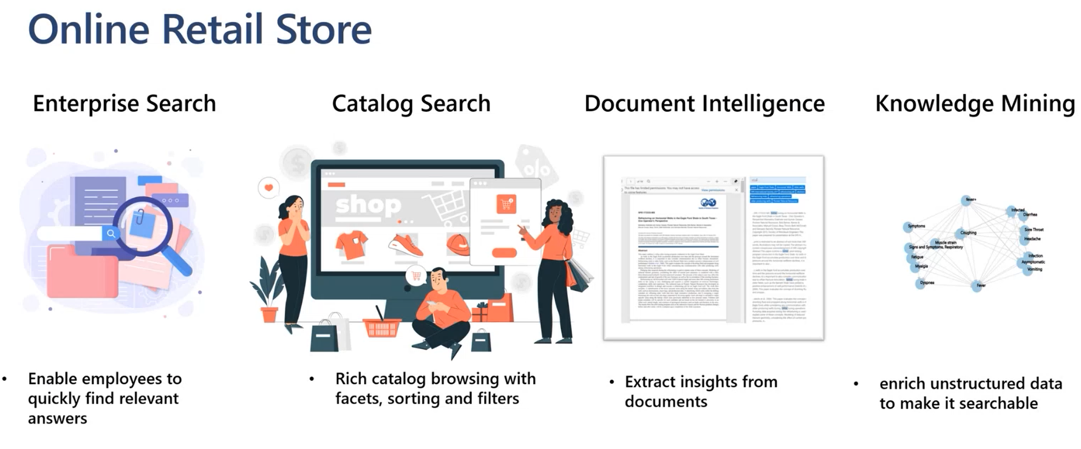

Slide 3
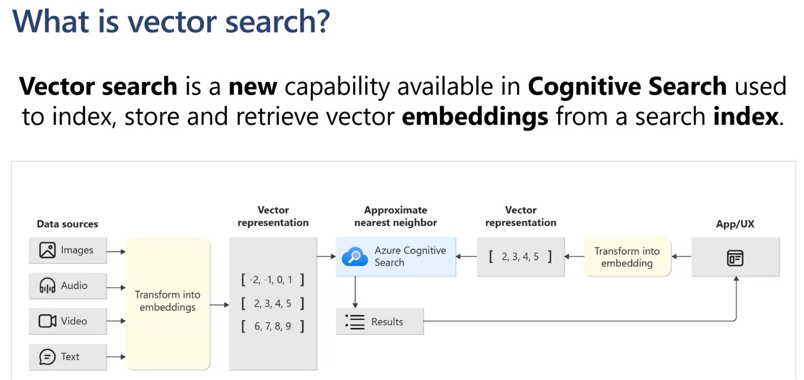

Slide 4


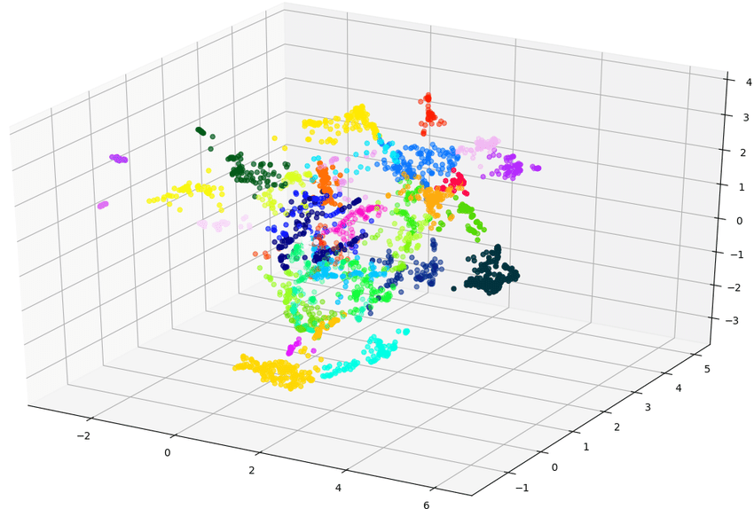





Chunking
index
1
code block
3
Azure Search Vector
Web UI
Embedding
2
Azure Open AI
Embedding

Slide 5
Azure Open AI
GPT
4
prompt
5
3
Vector Search
Azure Search Vector
Web UI
code block
1
2
Embedding
Azure Open AI
Embedding

Slide 6
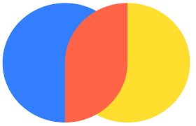
Chunking
index
1
code block
3
Vector Search by Chroma
Web UI
Embedding
2
Chroma
Embedding

Slide 7

Azure Open AI
GPT
Llama 2
4
prompt
5
3
Vector Search
Vector Search by Chroma
Web UI
code block
1
2
Embedding
Chroma
Embedding

